Slide 1
How to care for our planet
Care for Creation Team

Slide 2
“The earth is the Lord′s, and everything in it, the world, and all who live in it; for he founded it upon the seas and established it upon the waters.” Psalm 24:1-2

Slide 3
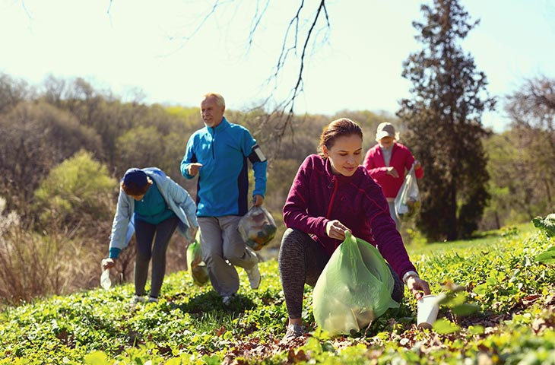



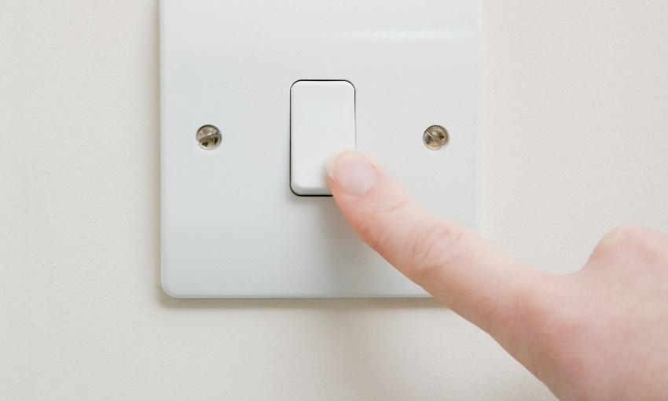
What can you do?

Slide 4


