Slide 1
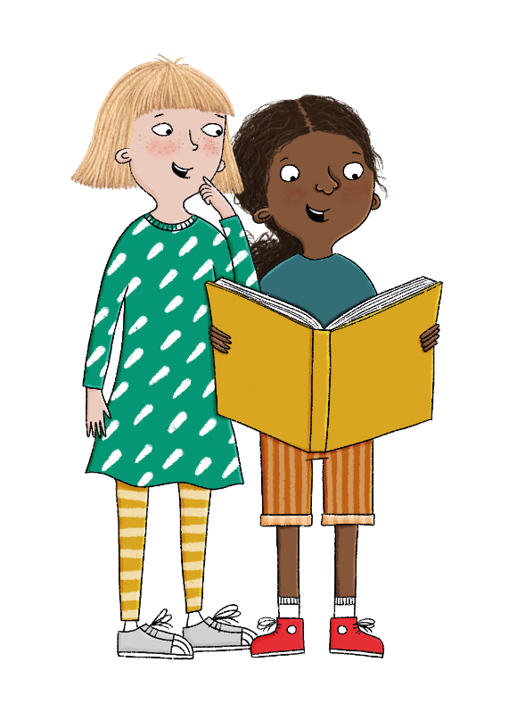
Copyright © ArkCurriculum+ 2022

Slide 2
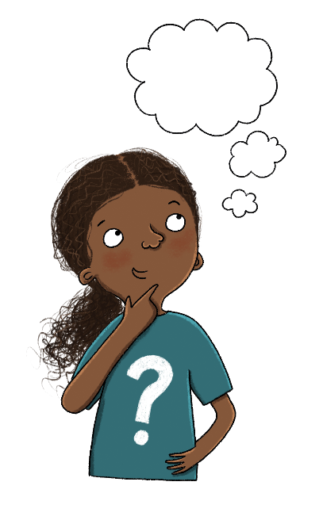
Knowledge quiz 3.3
1. Which word means the traits or appearance of a living thing?
inheritance
characteristics
offspring
artificial selection
2. Which word means the passing on of characteristics to young?
inheritance
characteristics
offspring
artificial selection
Copyright © ArkCurriculum+ 2022
Notes:
Knowledge quiz: Begin the lesson with the knowledge quiz. The knowledge quiz is a low-stakes way of assessing the knowledge retained from the previous lesson. Pupils answer the questions in the pupil workbooks and record their scores on the knowledge quiz scores page. Answers are included on the teaching slides.

Slide 3
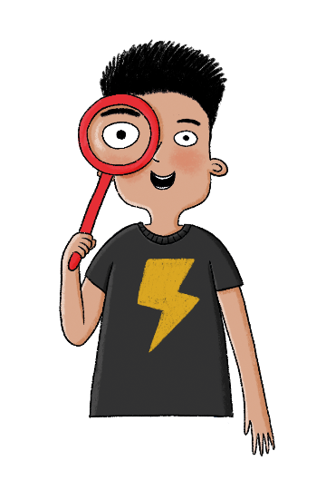
Knowledge quiz 3.3
3. Which of these is a word for the young created when living things reproduce?
inheritance
characteristics
offspring
artificial selection
4. Which word means the planned combination of two living
things to create a new living thing with a specific purpose?
inheritance
characteristics
offspring
artificial selection
Copyright © ArkCurriculum+ 2022
Notes:
Knowledge quiz: Begin the lesson with the knowledge quiz. The knowledge quiz is a low-stakes way of assessing the knowledge retained from the previous lesson. Pupils answer the questions in the pupil workbooks and record their scores on the knowledge quiz scores page. Answers are included on the teaching slides.

Slide 4

Knowledge quiz 3.3
5. Do offspring look identical to their parents?
yes
no
Copyright © ArkCurriculum+ 2022
Notes:
Knowledge quiz: Begin the lesson with the knowledge quiz. The knowledge quiz is a low-stakes way of assessing the knowledge retained from the previous lesson. Pupils answer the questions in the pupil workbooks and record their scores on the knowledge quiz scores page. Answers are included on the teaching slides.

Slide 5
Knowledge quiz 3.3
1. Which word means the traits or appearance of a living thing?
inheritance
characteristics
offspring
artificial selection
2. Which word means the passing on of characteristics to young?
inheritance
characteristics
offspring
artificial selection
Copyright © ArkCurriculum+ 2022
Notes:
Knowledge quiz: Begin the lesson with the knowledge quiz. The knowledge quiz is a low-stakes way of assessing the knowledge retained from the previous lesson. Pupils answer the questions in the pupil workbooks and record their scores on the knowledge quiz scores page. Answers are included on the teaching slides.

Slide 6
Knowledge quiz 3.3
3. Which of these is a word for the young created when living things reproduce?
inheritance
characteristics
offspring
artificial selection
4. Which word means the planned combination of two living
things to create a new living thing with a specific purpose?
inheritance
characteristics
offspring
artificial selection
Copyright © ArkCurriculum+ 2022
Notes:
Knowledge quiz: Begin the lesson with the knowledge quiz. The knowledge quiz is a low-stakes way of assessing the knowledge retained from the previous lesson. Pupils answer the questions in the pupil workbooks and record their scores on the knowledge quiz scores page. Answers are included on the teaching slides.

Slide 7
Knowledge quiz 3.3
5. Do offspring look identical to their parents?
yes
no
Copyright © ArkCurriculum+ 2022
Notes:
Knowledge quiz: Begin the lesson with the knowledge quiz. The knowledge quiz is a low-stakes way of assessing the knowledge retained from the previous lesson. Pupils answer the questions in the pupil workbooks and record their scores on the knowledge quiz scores page. Answers are included on the teaching slides.

Slide 8
Evolution and inheritance
What can fossils tell us?
What is natural selection?
1
6
2
7
What is variation?
What is the theory of
evolution?
3
What is inheritance?
8
What is evolution?
4
Why do animals become
extinct?
What is an adaptation?
9
5
Why do animals have adaptations?
10
How can we save
endangered animals?
Copyright © ArkCurriculum+ 2022
Notes:
Introduction: Share the learning journey through the unit and the lesson question, key knowledge, and key vocabulary.

Slide 9
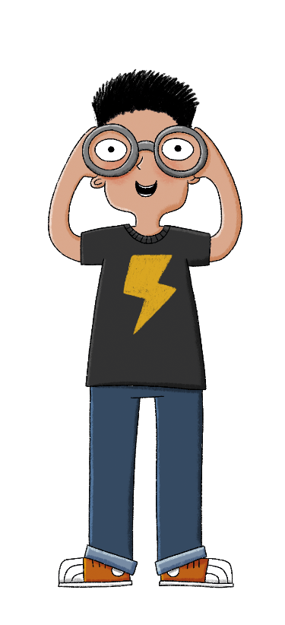
Why do animals have adaptations?
Key vocabulary
adaptation
environment
habitat
survive
Key knowledge
An adaptation is a special feature or characteristic that helps a living thing survive in its habitat.
Some adaptations help the animal or plant to survive the climate of its environment.
Some adaptations help living things to survive seasonal changes.
Some adaptations help living things to find food and water.
Some adaptations help living things survive the threat of predators.
Copyright © ArkCurriculum+ 2022
Notes:
Introduction: Share the learning journey through the unit and the lesson question, key knowledge, and key vocabulary.

Slide 10






Working Scientifically
Make detailed observations
Ask scientific questions and plan enquiries
Evaluate results and draw scientific conclusions
In UKS2 we…
Set up fair tests with controlled variables
Make informed, scientific predictions
Accurately record results and data

Slide 11
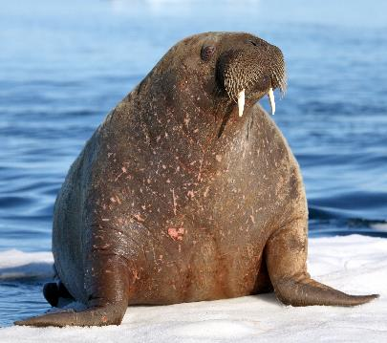
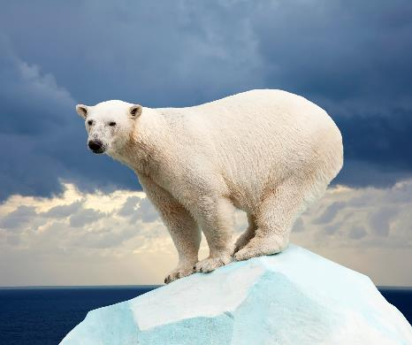

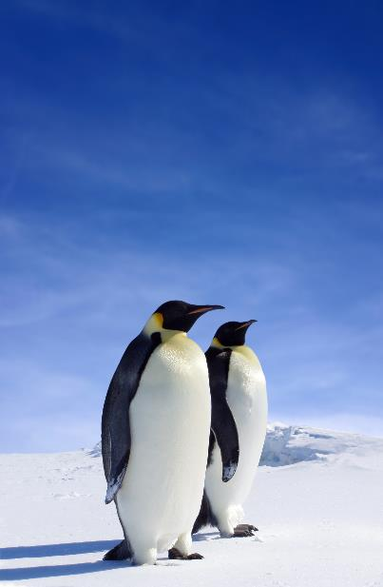
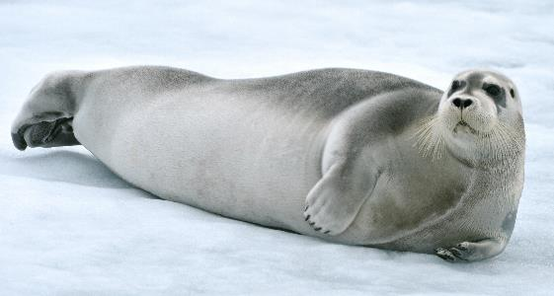
How have these species adapted to their cold environment?
Copyright © ArkCurriculum+ 2022
Notes:
Talk task: Pupils look at the photos on the teaching slide and think about how the species have adapted to their cold environments: for example, some have blubber or thick fur.

Slide 12
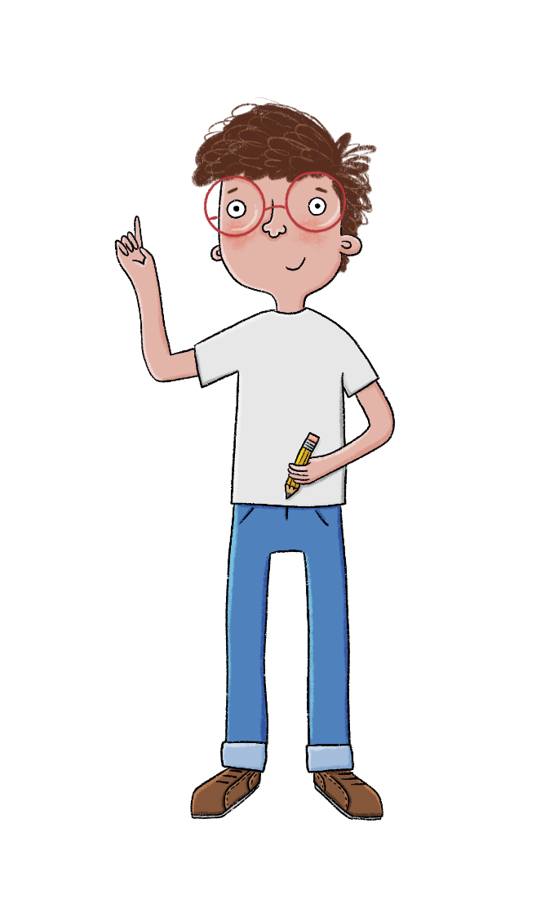
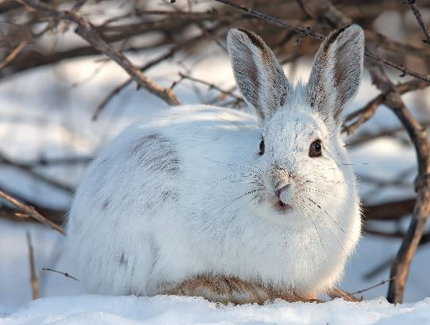
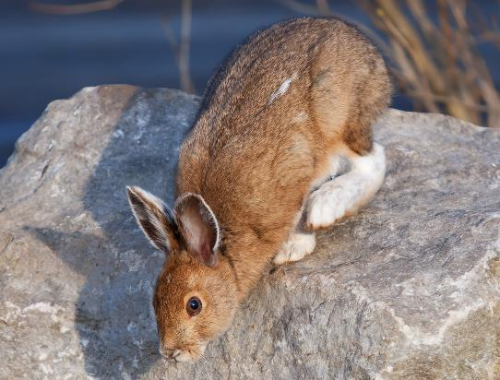
How is the snowshoe hare adapted to help it survive?
Snowshoe hare in winter
Snowshoe hare in summer
Copyright © ArkCurriculum+ 2022
Notes:
Talk task: Pupils answer the question about how the snowshoe hare has adapted to help it survive in its environment, using the images on the teaching slides.

Slide 13
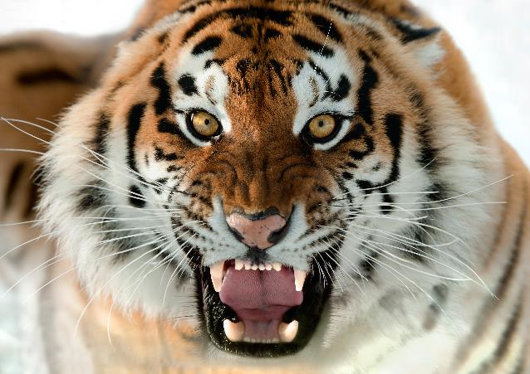
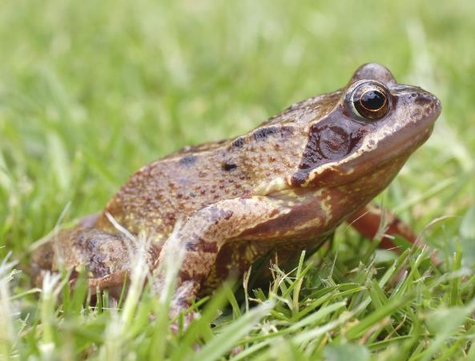
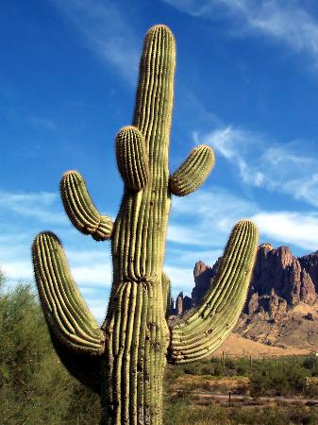


How are these organisms adapted to help them survive? Label each picture and write an explanation.
Copyright © ArkCurriculum+ 2022
Notes:
Write: Pupils answer questions in the pupil workbooks about how the tiger, common frog, and cactus have adapted to their environments.

Slide 14
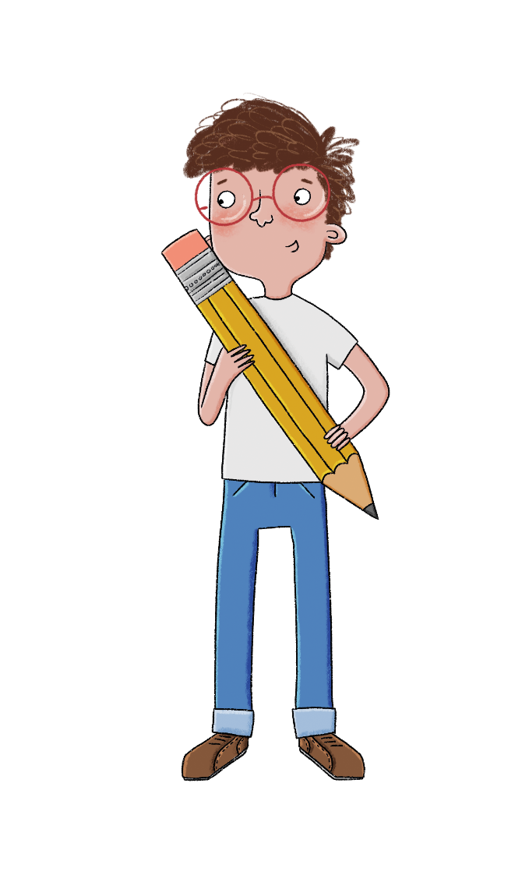
Research and present
1. Research any of the organisms (living things) and find out how it is adapted to its environment.
2. Create an information leaflet – you could produce a paper leaflet or use IT to produce a digital presentation, for example a powerpoint - explaining how the organism is adapted to its environment.
Copyright © ArkCurriculum+ 2022
Notes:
Write: Pupils then research another organism and design a poster, labelling the organism’s features that help it to adapt to its environment.

Slide 15
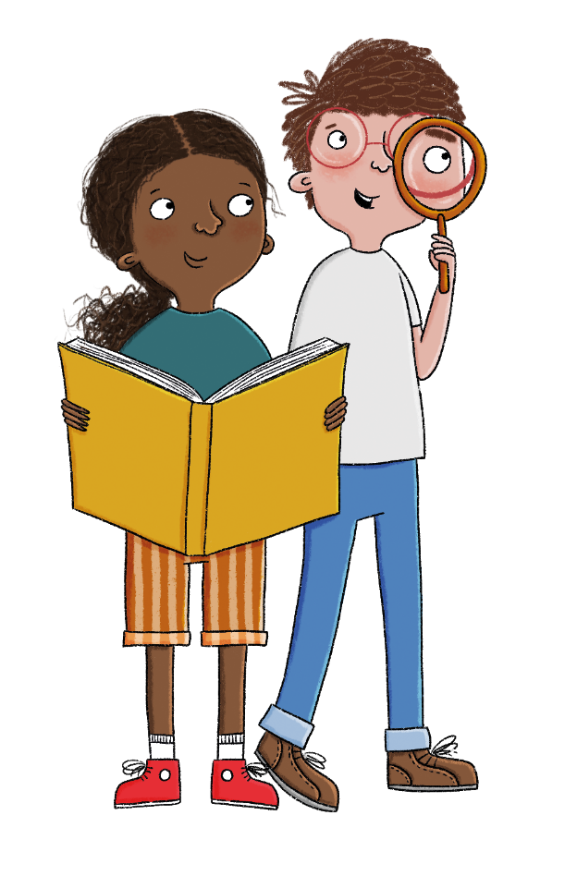
Why do animals have adaptations?
Can you tell your partner an answer to the lesson question?
What key learning helps you to answer the question?
Copyright © ArkCurriculum+ 2022
Notes:
Learning review: Talk partners tell each other a response to the main lesson question: ‘Why do animals have adaptations?’. Add further review questions if you wish to. Urge pupils to use their key knowledge and vocabulary to answer the question. Pairs can try to improve one another’s understanding (peer assess). Take some examples of answers to discuss as a class. Use this as an assessment opportunity. Should you wish to, you might ask pupils to write a short independent response to the main lesson question.

Slide 16

Exit question 1
Answer this multiple-choice question about your learning so far. Hold up one, two, or three fingers to show your answer!
How is the snowshoe hare adapted to help it survive?
1. It loses its fur.
2. Its fur changes colour.
3. Its ears grow.
Copyright © ArkCurriculum+ 2022
Notes:
Exit questions: Ask pupils to answer the multiple-choice exit questions by holding up one, two, or three fingers to choose an answer. The exit questions can be found on the final teaching slides for this lesson.

Slide 17
Exit question 1
Answer this multiple-choice question about your learning so far. Hold up one, two, or three fingers to show your answer!
How is the snowshoe hare adapted to help it survive?
1. It loses its fur.
2. Its fur changes colour.
3. Its ears grow.
Copyright © ArkCurriculum+ 2022
Notes:
Exit questions: Ask pupils to answer the multiple-choice exit questions by holding up one, two, or three fingers to choose an answer. The exit questions can be found on the final teaching slides for this lesson.

Slide 18
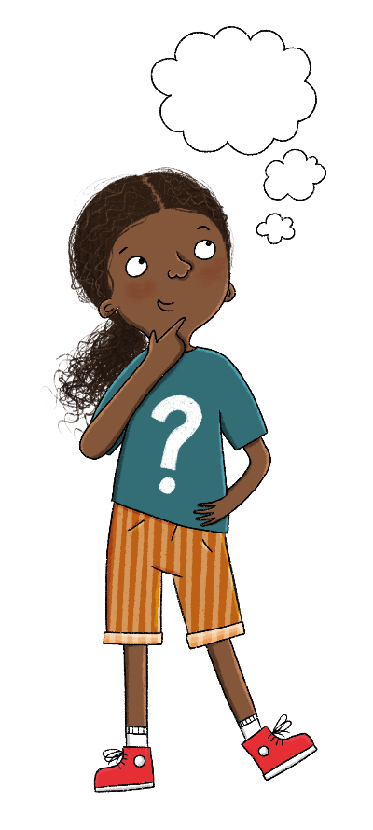
Exit question 2
Answer this multiple-choice question about your learning so far. Hold up one, two, or three fingers to show your answer!
Which of these characteristics helps the tiger to blend into its environment?
1. its sharp teeth and claws
2. its striped coat
3. its large size
Copyright © ArkCurriculum+ 2022
Notes:
Exit questions: Ask pupils to answer the multiple-choice exit questions by holding up one, two, or three fingers to choose an answer. The exit questions can be found on the final teaching slides for this lesson.

Slide 19
Exit question 2
Answer this multiple-choice question about your learning so far. Hold up one, two, or three fingers to show your answer!
Which of these characteristics helps the tiger to blend into its environment?
1. its sharp teeth and claws
2. its striped coat
3. its large size
Copyright © ArkCurriculum+ 2022
Notes:
Exit questions: Ask pupils to answer the multiple-choice exit questions by holding up one, two, or three fingers to choose an answer. The exit questions can be found on the final teaching slides for this lesson.

