Slide 1

Mental Health and Wellbeing
St. Francis Xavier Catholic Primary School
Subject lead: Ms Wells

Slide 2
Intent Implement Impact
Children to be:
happy
confident
resilient
make links to their own emotions and feelings and also understand the feelings and emotions of others around them.
Children will identify and develop their understanding of an assortment of feelings and emotions. This will be linked to:
RE
PE
Literacy
Reading
Mindfulness
Children at St Francis Xavier to be resilient, confident and happy with a good understanding of their feelings and emotions and how to regulate them and to build good emotional intelligence throughout the school.

Slide 3
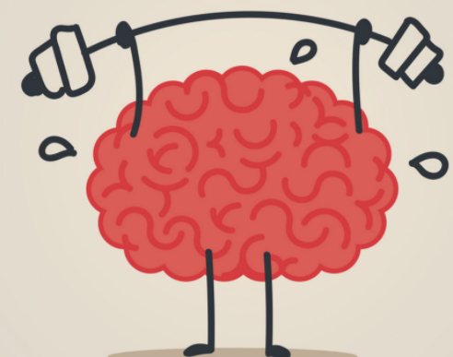
Mental Health: Includes our emotional, psychological and social wellbeing. It effects how we think, feel and act.
Wellbeing is: The state of being comfortable, healthy or happy.
Mindfulness is: The human ability to be fully present, aware of where we are and what we are doing ‘the here and now’.
Emotional intelligence is: The ability to perceive, control and evaluate emotions.

Slide 4
How Mental Health and Wellbeing is taught at St Francis Xavier.
Discovering - As children progress through school, they will develop new emotions and feelings and discover new ways to regulate them.
Developing - Applying their skills and understanding through a range of curricular subjects, allowing them to progress within all areas of their development and providing the opportunity to explore their feelings within subjects such as writing, RE, PE and art.
Extending learning - Children will have the opportunity to practice mindfulness and relaxation techniques, be encouraged to discuss their feelings and learn how to be resilient providing them with opportunities to be happy and more confident.

Slide 5

At St Francis Xavier we aim for children to be able to apply their emotional intelligence in various ways. We are continuously striving to promote mental health and wellbeing through cross-curricular links.
This at present includes writing in a range of contexts, reading about different situations or specific areas being taught, understanding gratitude through RE and linking our knowledge to keeping physically fit and healthy through PE and understanding why they are both equally important.
Year 5 and 6 wrote a letter explaining what areas of mental health and wellbeing they enjoyed and what they would like to do more of, this enabled the childs voice to be heard.
Cross Curriculum links

Slide 6
National curriculum:
The national curriculum for mental wellbeing aims to ensure that by the end of primary school pupils should know:
That mental wellbeing is a normal part of daily life, in the same way as physical health.
That there is a normal range of emotions such as happiness, sadness, anger and fear that we all experience in relation to different experiences and situations.
How to recognise and talk about their own emotions and use varied vocabulary when discussing their own and others’ feelings.
The benefits of physical exercise.
Simple self care techniques.
That bullying including cyberbullying can have a negative and lasting impact on mental wellbeing.

Slide 7

What children say about Mental Health and Wellbeing:
“I have learnt to keep trying and never give up. It’s ok to make mistakes when you are trying something new.” Year 5
“I have learnt to always speak to a trusted adult about how I feel and if I’m angry take time to calm down and focus on my breathing and feelings for a few minutes.” Year 6
“I know different ways to relax and calm down when I feel anxious or worried.” Year 4
“I can describe the feelings of happiness” Year 1
“ I understand different things that help me to build my resilience in school, to keep trying and not give up and to be positive” Year 3

